Slide 1



Computer Vision
Project Presentation
Sign Language Translator
A comparison of different architectures for LIS, BSL and ASL alphabet classification
Perfetto Ida, Mascolo Anna Pia, Serra Viviana

Slide 2

Project Description
Datasets employed
Architectures description & Results
Comparison of the obtained results

Slide 3
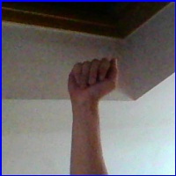
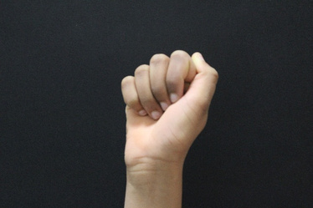
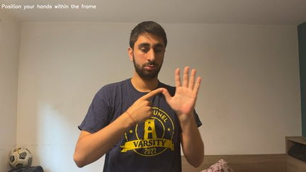
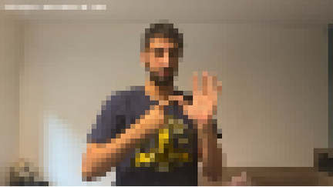
Datasets employed
ASL: American Sign Language [1]
the biggest dataset:
26 classes of 3000 samples each
LIS: Italian Sign Language Fingerspelling Dataset [2]
the smallest and most unbalanced dataset:
22 classes with a number of samples in the range [240, 330]
BSL Numbers & Alphabet Hand Position For MediaPipe [3]
the most different and noisy dataset:
23 classes of 1000 samples each, with subject performing gestures in a
real-world environment
3
Sign Language Translator: Datasets employed

Slide 4
Datasets employed
Dataset balancing has been done, obtaining:
ASL(1000) and ASL(300)
BSL(1000) and BSL(300)
LIS(1000) and LIS(300)
ASL(300), BSL(300) and LIS(300) were put together in order to obtain the Combined dataset

Slide 5
Architectures description
ResNet50
VGG (16 & 19)
MobileNetV2
EfficientNetV2
(Perfetto Ida)
(Mascolo Anna Pia)
(Serra Viviana)
(Serra Viviana)

Slide 6

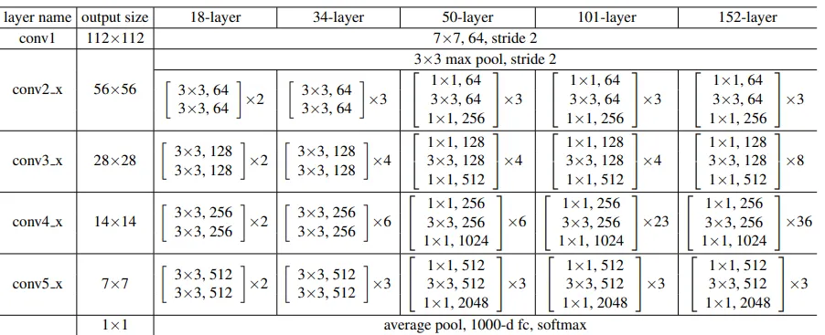
ResNet50
ResNet50 is a deep learning model launched
by Microsoft Research. Its 50 layers
architecture focuses on residual learning and
involves:
input layer, it accepts (224, 224, 3) tensors (224x224 RGB images)
convolutional layer, with a 7x7 filter, 64 filters, and a stride of 2, it processes the input image to detect features and generate feature maps
3x3 max pooling layer with a stride of 2, to downsample the spatial dimensions of the feature maps, retaining important information and reducing computational load
source[4]
The key feature of this model is the use of the residual blocks, that connect the activations of previous layers with the next one.
This allows the network to skip in-between layers and mitigate the vanishing or exploding gradient problem, letting it flow without being altered by a large magnitude and facilitating smoother training and faster convergence
6
Sign Language Translator: Architectures Description

Slide 7
ResNet50
4 residual blocks, each one with a specific number of units of 1x1 convolution, 3x3 convolution, and again 1x1 convolution and a variable number of filters
an average pooling layer, that reduces the spatial dimensions of the feature maps to a single value per feature, simplifying the architecture
a fully connected layer with 1000 neurons
a softmax activation in the output layer, where the reduced feature maps undergo a final classification step producing the model's predictions
source[4]
The key feature of this model is the use of the residual blocks, that connect the activations of previous layers with the next one.
This allows the network to skip in-between layers and mitigate the vanishing or exploding gradient problem, letting it flow without being altered by a large magnitude and facilitating smoother training and faster convergence
7
Sign Language Translator: Architectures Description

Slide 8
ResNet50
To thoroughly test the capabilities of ResNet50, with its number of trainable layers being approximately double that the one of the other architectures, I challenged this model aslo with datasets of 1000 images per class.
In order to maximize the performances, each dataset has been tested with 6 trials, varying by 3 factors:
Learning rate: 1e-4 or 1e-5
Base model layers unfrozen: none or only BatchNormalization layers
BatchNormalization layers contain learned parameters (mean and variance) that align the model with the original
dataset's distribution . By unfreezing these layers, the model can adapt to the new dataset, improving accuracy,
especially for large datasets [5]
Dense regularization: adding L2 regularization to the Dense layer or not
Dense layer regularization, through L2 penalties, discourages large weight magnitudes, which can lead to
overfitting [6]
8
Sign Language Translator: Architectures Description

Slide 9
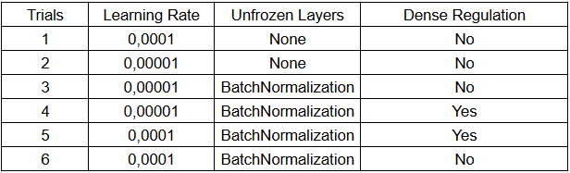
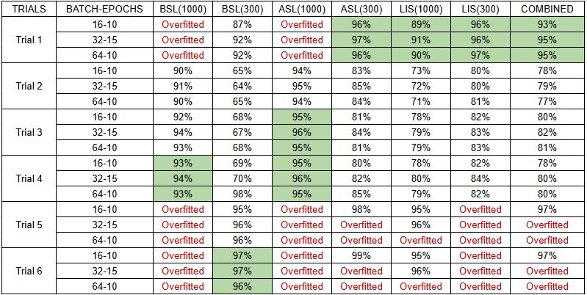
ResNet50
LIS Dataset
The images feature a clean, uniform black background with no distractions. The hand centered, and isolated, is in clear contrast with the background.
These characteristics simplify the feature extraction process for the model, making it easier to focus on the relevant details of the gesture: the risk of overfitting or confusion is minimized leading to higher accuracy during training, validation, and test.
9
Sign Language Translator: Results

Slide 10
ResNet50
ASL Dataset
The images have a lower resolution and poor lighting, resulting in low contrast between the hand and the background.
BatchNormalization layers could adapt slowly, due to the lower learning rate, to the noise and complexity of the bigger dataset. Good results were obtained also with the Regularization of the Dense layer that compensated for noise and poor lighting, leading to better generalization.
10
Sign Language Translator: Results

Slide 11
ResNet50
BSL Dataset
The images include complex backgrounds, some gestures involve full-body poses or contextual elements rather than focusing on the hand.
These characteristics make the input space more complex: it required slower, more deliberate optimization to prevent the model from latching onto irrelevant background features.
11
Sign Language Translator: Results

Slide 12
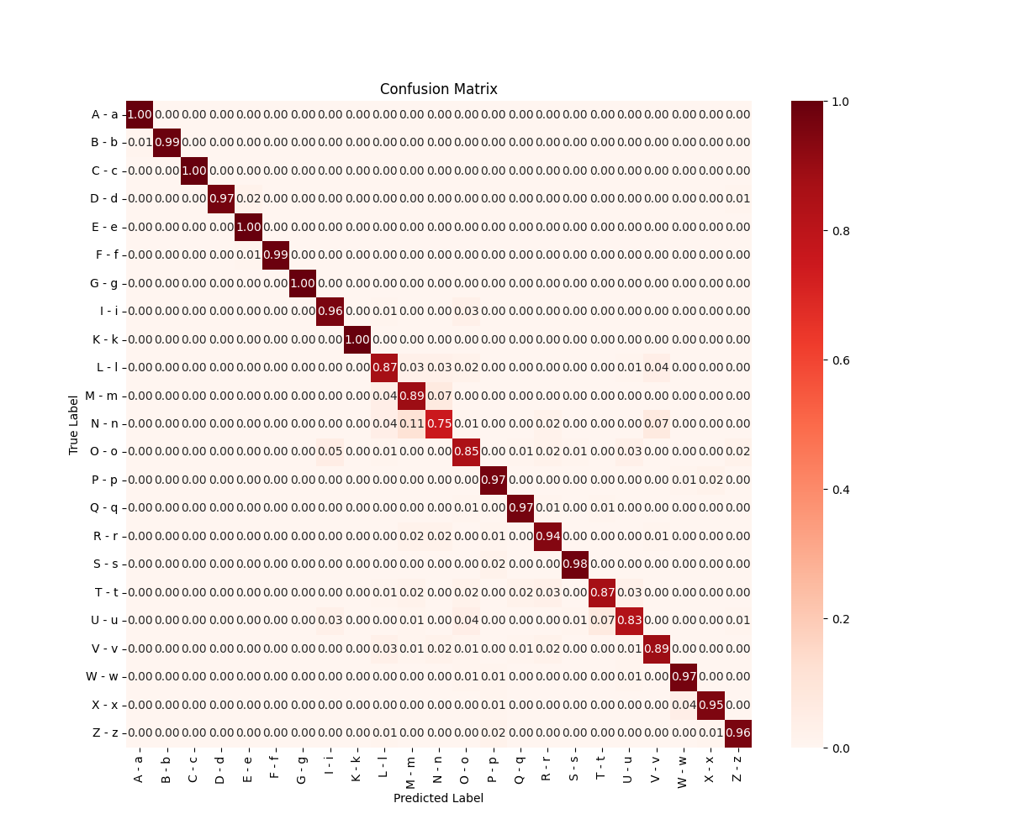
ResNet50
BSL (1000)
Batch/Epochs | Accuracy | Precision | Recall | F1 Score
16/10 | 0.93 | 0.93 | 0.93 | 0.93
32/15 | 0.94 | 0.94 | 0.94 | 0.94
64/20 | 0.93 | 0.93 | 0.93 | 0.93
12
Sign Language Translator: Results

Slide 13
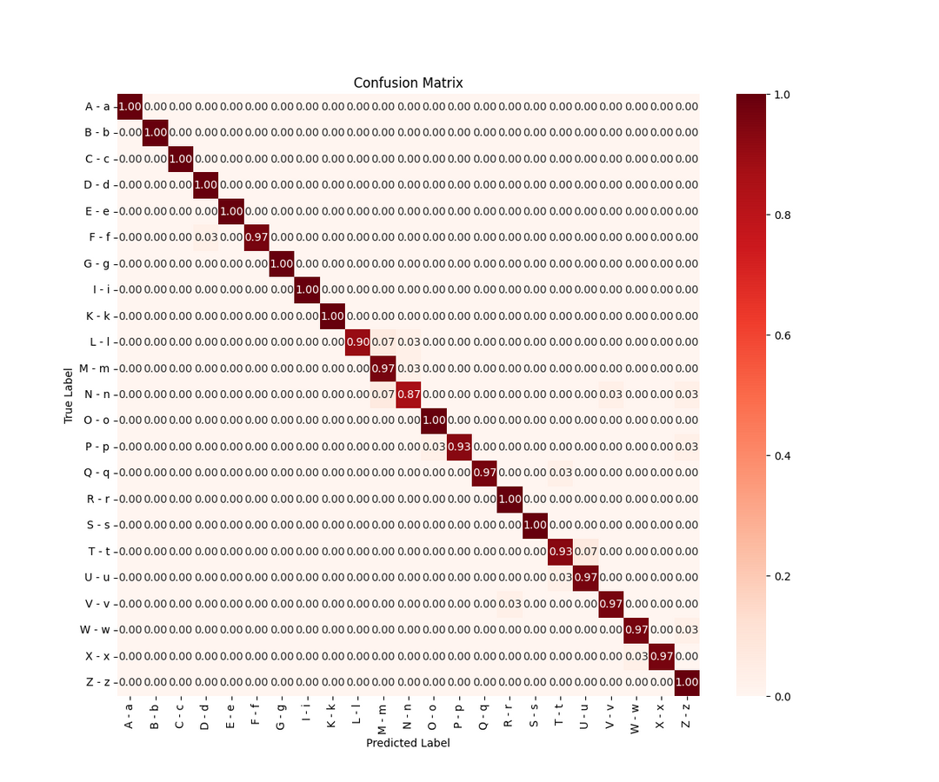
ResNet50
BSL(300)
Batch/Epochs | Accuracy | Precision | Recall | F1 Score
16/10 | 0.97 | 0.97 | 0.97 | 0.97
32/15 | 0.97 | 0.97 | 0.97 | 0.97
64/20 | 0.96 | 0.96 | 0.96 | 0.96
13
Sign Language Translator: Results

Slide 14
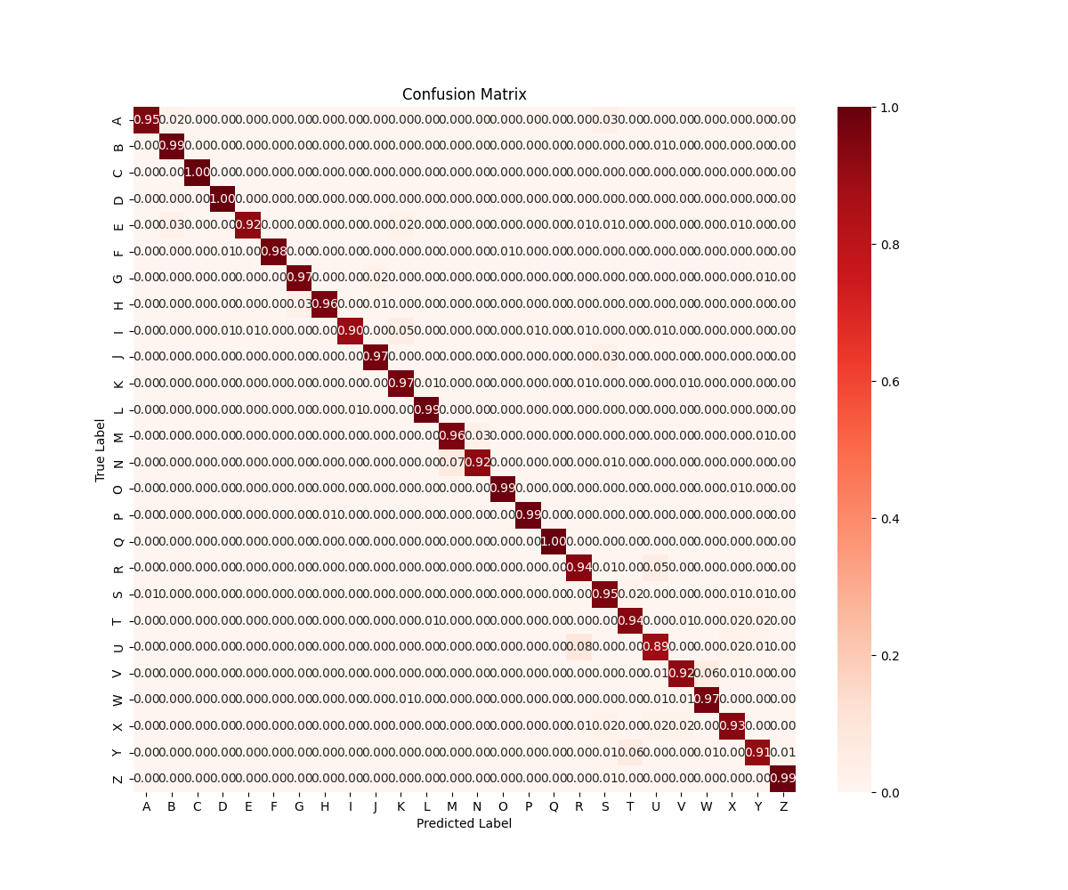
ResNet50
ASL (1000)
Batch/Epochs | Accuracy | Precision | Recall | F1 Score
16/10 | 0.95 | 0.95 | 0.95 | 0.95
32/15 | 0.96 | 0.96 | 0.96 | 0.96
64/20 | 0.95 | 0.95 | 0.95 | 0.95
14
Sign Language Translator: Results

Slide 15
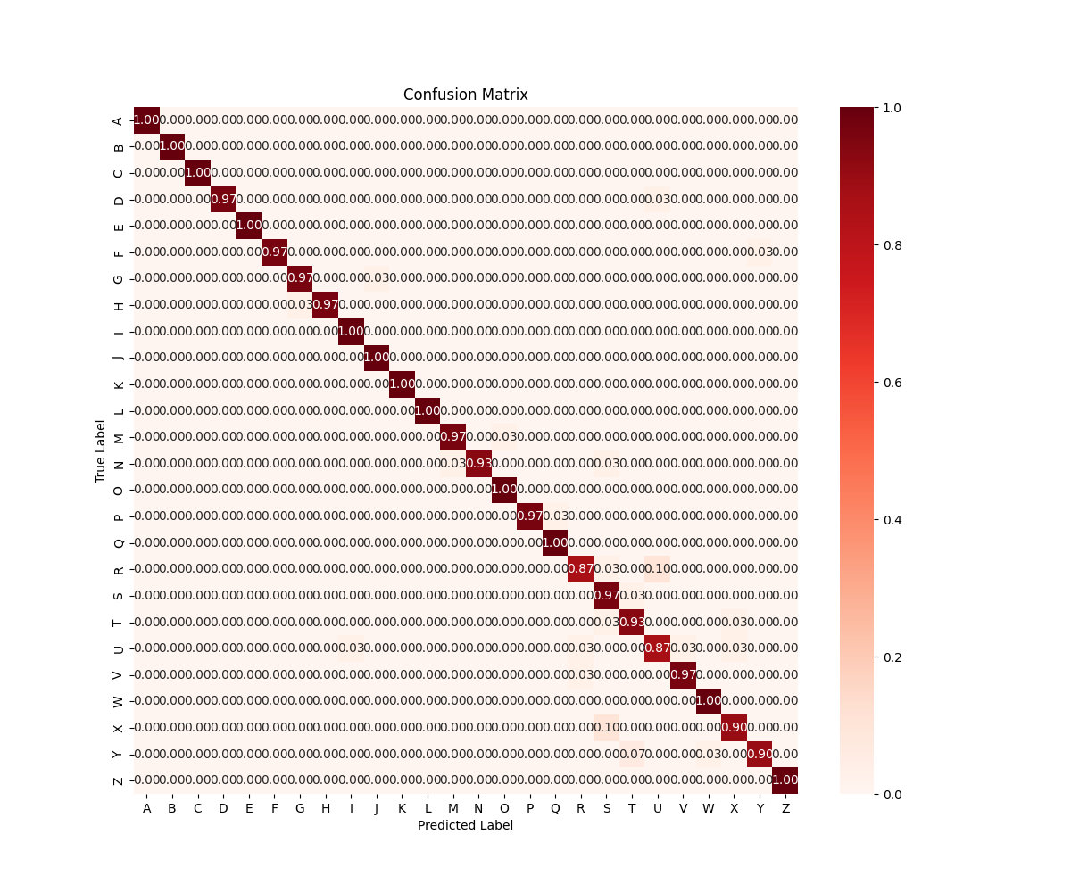
ResNet50
ASL(300)
Batch/Epochs | Accuracy | Precision | Recall | F1 Score
16/10 | 0.96 | 0.96 | 0.96 | 0.96
32/15 | 0.97 | 0.97 | 0.97 | 0.97
64/20 | 0.96 | 0.96 | 0.96 | 0.96
15
Sign Language Translator: Results

Slide 16
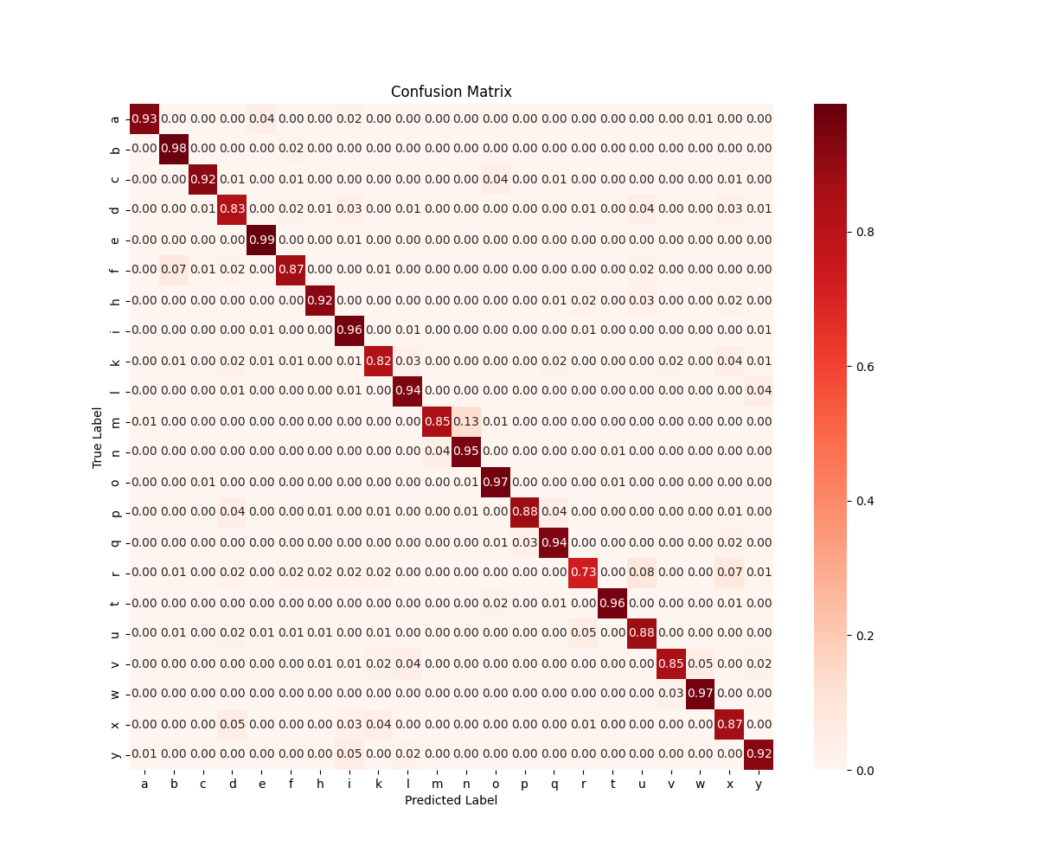
ResNet50
LIS(1000)
Batch/Epochs | Accuracy | Precision | Recall | F1 Score
16/10 | 0.89 | 0.90 | 0.89 | 0.89
32/15 | 0.91 | 0.91 | 0.91 | 0.91
64/20 | 0.90 | 0.90 | 0.90 | 0.90
16
Sign Language Translator: Results

Slide 17
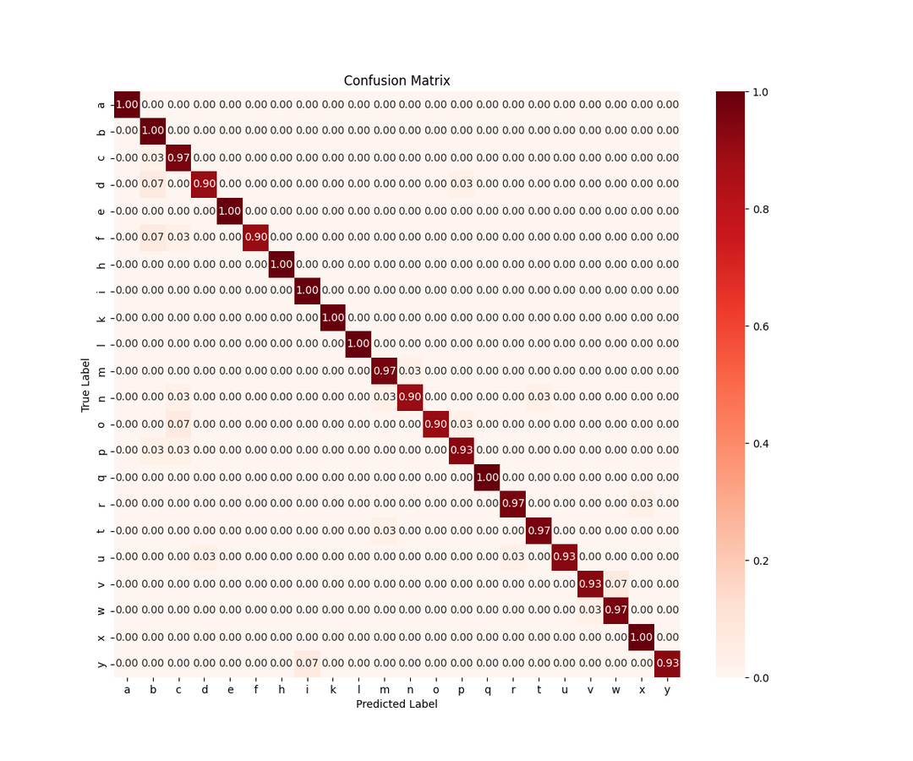
ResNet50
LIS(300)
Batch/Epochs | Accuracy | Precision | Recall | F1 Score
16/10 | 0.96 | 0.96 | 0.96 | 0.96
32/15 | 0.96 | 0.96 | 0.96 | 0.96
64/20 | 0.97 | 0.97 | 0.97 | 0.97
17
Sign Language Translator: Results

Slide 18
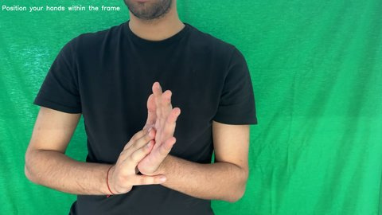
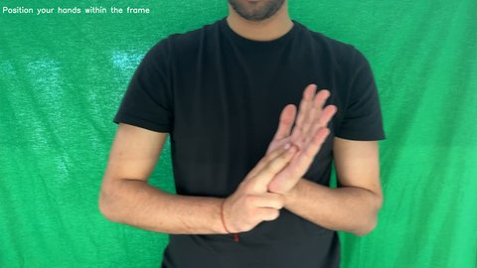
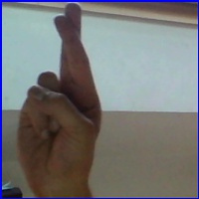
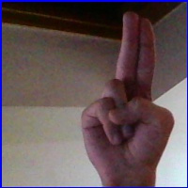
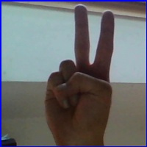
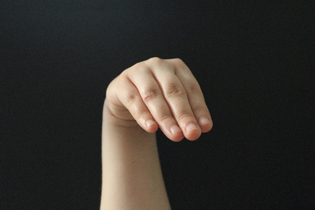
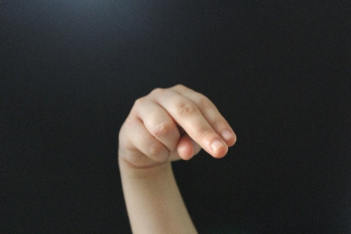
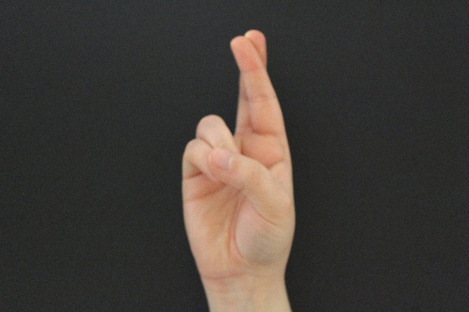
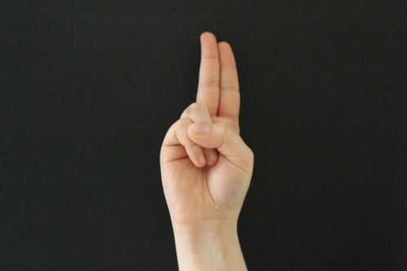
ResNet50
BSL
ASL
LIS
M
N
R
U
V
M
N
R
U
18
Sign Language Translator: Results

Slide 19

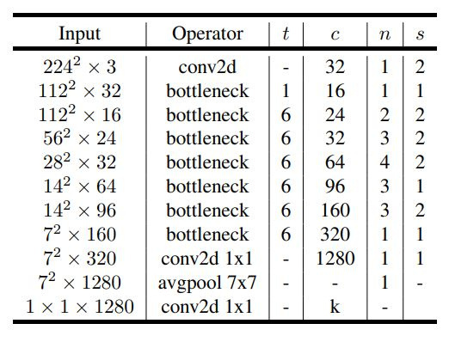
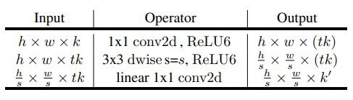

MobileNetV2
Model architecture
Bottleneck layer
MobileNetV2 is a convolutional neural network architecture that is based on an inverted residual structure where the residual connections are between the bottleneck layers.
source[7]
19
Sign Language Translator: Architectures Description

Slide 20
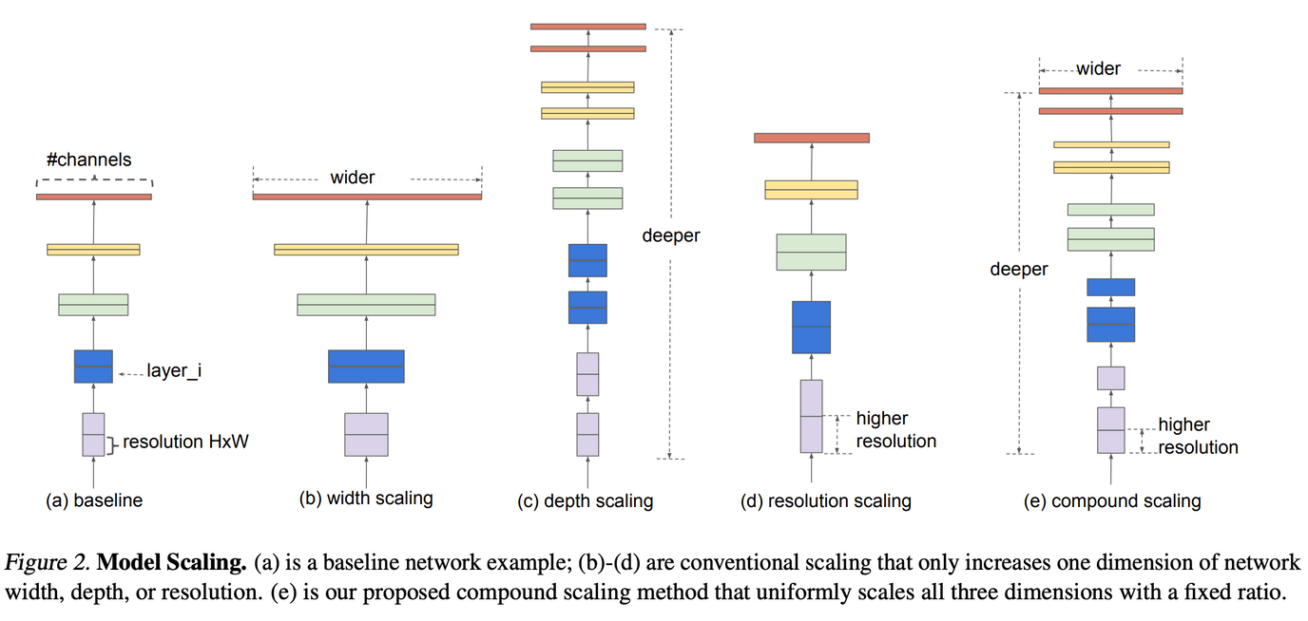
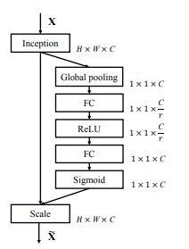
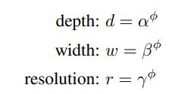
EfficientNetV2
Different scaling methods
squeeze and excitation block
equations for scaling coefficients
EfficientNet is a CNN architecture that adds squeeze-and-excitation blocks and it uses scaling method
source[8]
20
Sign Language Translator: Architectures Description

Slide 21
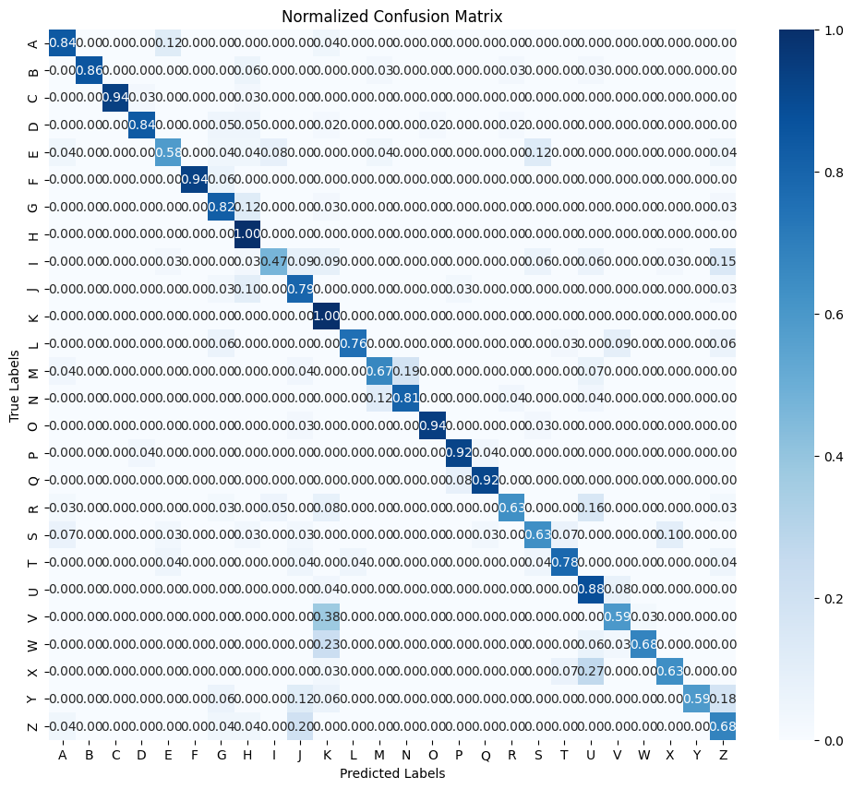
MobileNetV2-ASL
Batch/Epochs | Accuracy | Precision | Recall | F1 Score
16/10 | 0.78 | 0.82 | 0.78 | 0.78
32/15 | 0.76 | 0.80 | 0.76 | 0.76
64/20 | 0.77 | 0.81 | 0.77 | 0.77
21
Sign Language Translator: Results

Slide 22
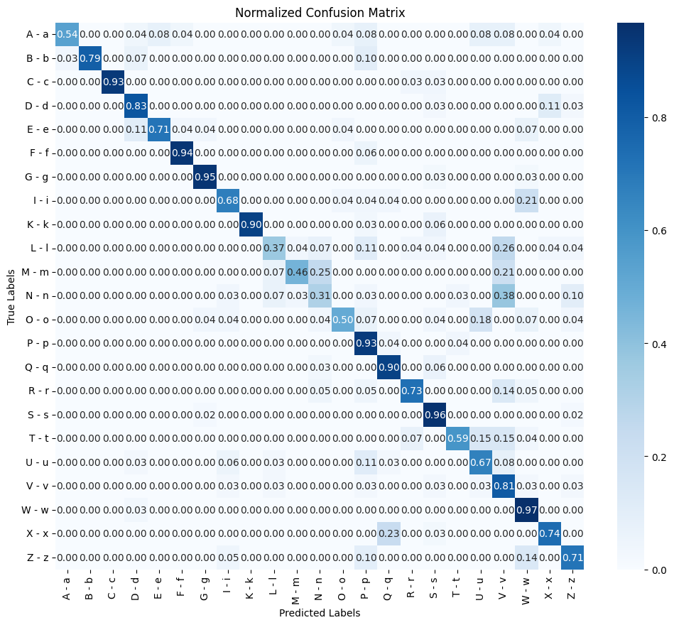
MobileNetV2-BSL
Batch/Epochs | Accuracy | Precision | Recall | F1 Score
16/10 | 0.74 | 0.77 | 0.74 | 0.73
32/15 | 0.75 | 0.78 | 0.75 | 0.74
64/20 | 0.70 | 0.76 | 0.70 | 0.70
22
Sign Language Translator: Results

Slide 23
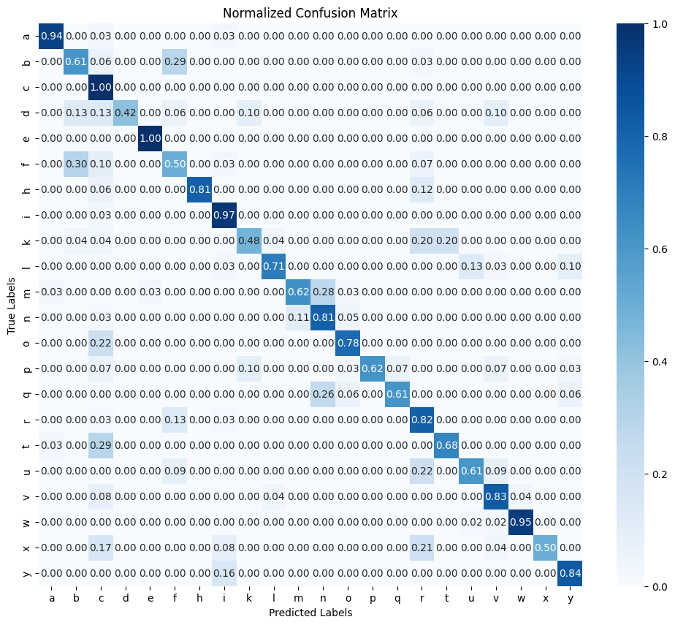
MobileNetV2-LIS
Batch/Epochs | Accuracy | Precision | Recall | F1 Score
16/10 | 0.73 | 0.79 | 0.73 | 0.73
32/15 | 0.74 | 0.80 | 0.74 | 0.74
64/20 | 0.73 | 0.78 | 0.73 | 0.73
23
Sign Language Translator: Results

Slide 24
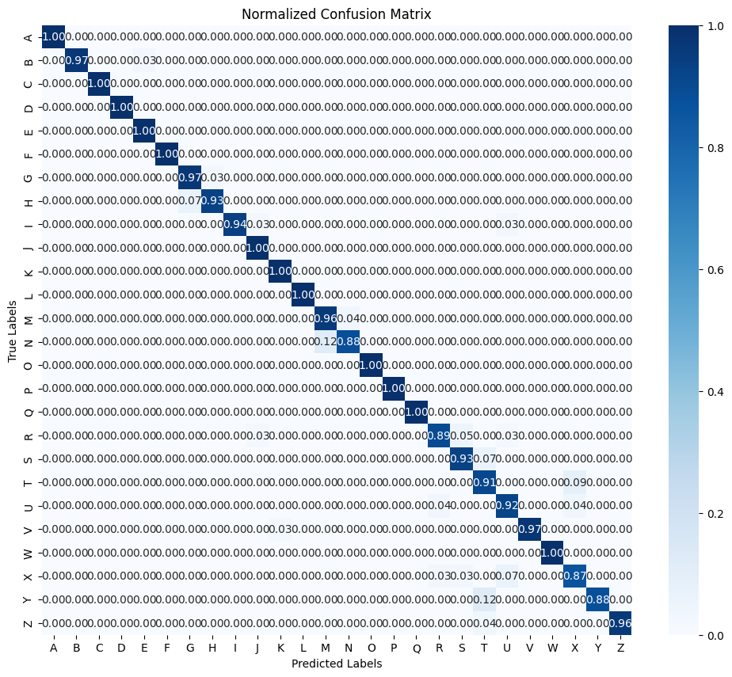
EfficientNetV2-ASL
Batch/Epochs | Accuracy | Precision | Recall | F1 Score
16/10 | 0.95 | 0.95 | 0.95 | 0.95
32/15 | 0.96 | 0.97 | 0.96 | 0.96
64/20 | 0.96 | 0.96 | 0.96 | 0.96
24
Sign Language Translator: Results

Slide 25
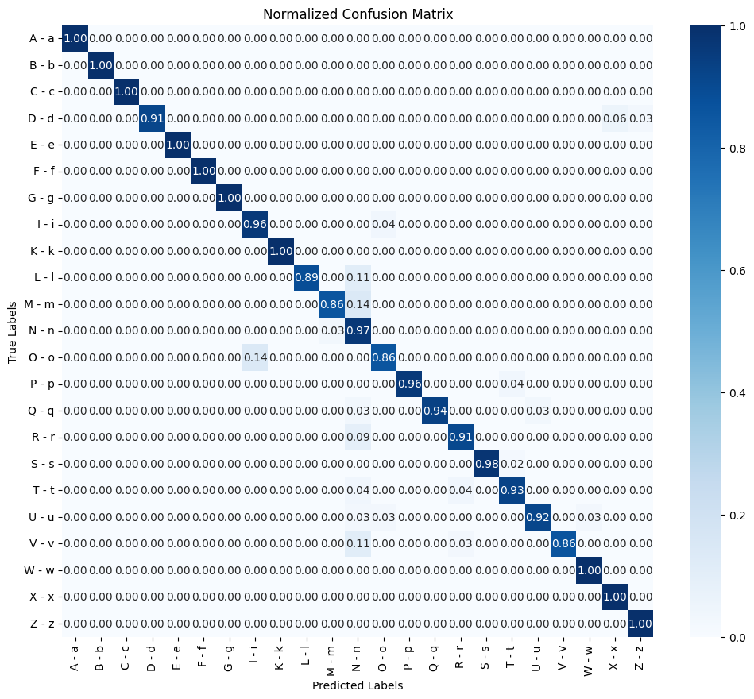
EfficientNetV2-BSL
Batch/Epochs | Accuracy | Precision | Recall | F1 Score
16/10 | 0.95 | 0.96 | 0.95 | 0.96
32/15 | 0.88 | 0.90 | 0.88 | 0.88
64/20 | 0.90 | 0.91 | 0.90 | 0.90
25
Sign Language Translator: Results

Slide 26
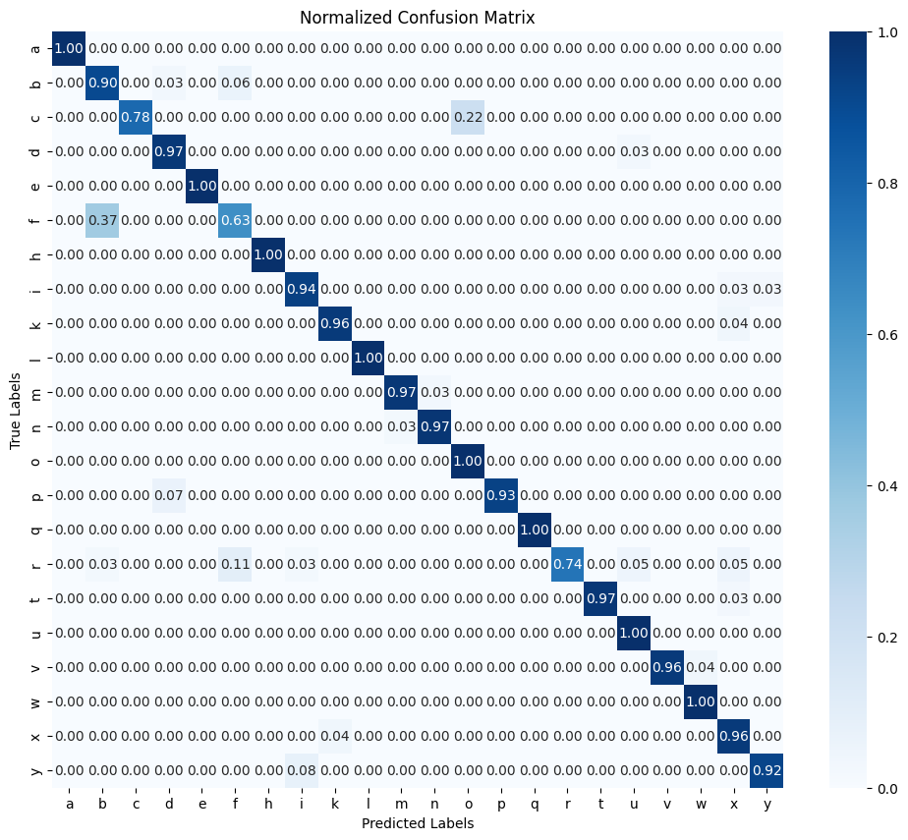
EfficientNetV2-LIS
Batch/Epochs | Accuracy | Precision | Recall | F1 Score
16/10 | 0.93 | 0.94 | 0.93 | 0.93
32/15 | 0.94 | 0.94 | 0.94 | 0.94
64/20 | 0.93 | 0.94 | 0.93 | 0.93
26
Sign Language Translator: Results

Slide 27

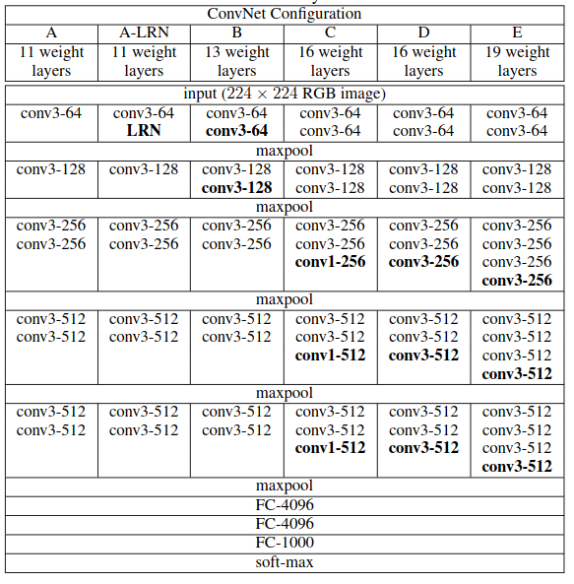
VGG
Source [9]
VGG is a deep convolutional neural network, with a very simple architecture:
input layer,
convolutional layer: 3x3 kernel and a stride of 1,
max pooling: 2x2 window and stride 2,
3 fully connected layers,
output layer.
27
Sign Language Translator: Architectures Description

Slide 28
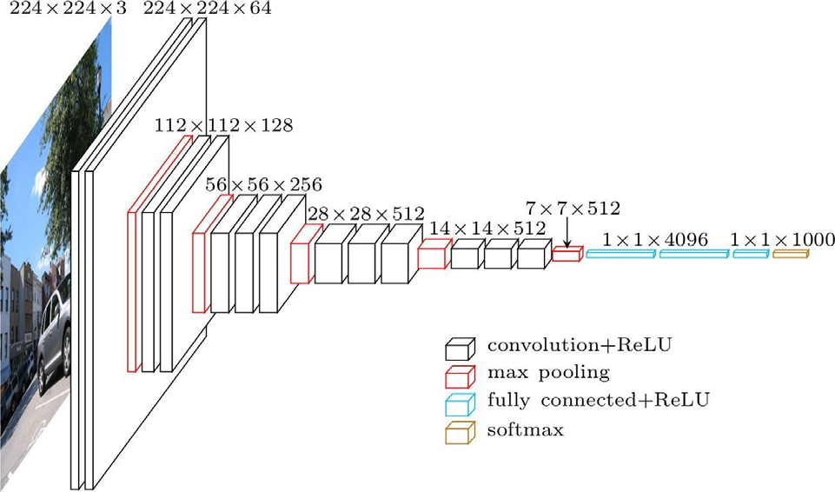
VGG
The extra depth of VGG19 allows it to learn more complex features.
Expected better results for a batch size of 32 and 15 epochs due to balance between training and generalization.
Source [10]
28
Sign Language Translator: Architectures Description

Slide 29
VGG16 LIS
VGG19 LIS
Batch/ Epochs | Accuracy | Precision | Recall | F1-score
16/10 | 0.97 | 0.97 | 0.97 | 0.97
32/15 | 0.97 | 0.97 | 0.97 | 0.97
64/20 | 0.98 | 0.98 | 0.98 | 0.98
Batch/ Epochs | Accuracy | Precision | Recall | F1-score
16/10 | 0.98 | 0.98 | 0.98 | 0.98
32/15 | 0.98 | 0.98 | 0.98 | 0.98
64/20 | 0.97 | 0.97 | 0.97 | 0.97
29
Sign Language Translator: Results

Slide 30
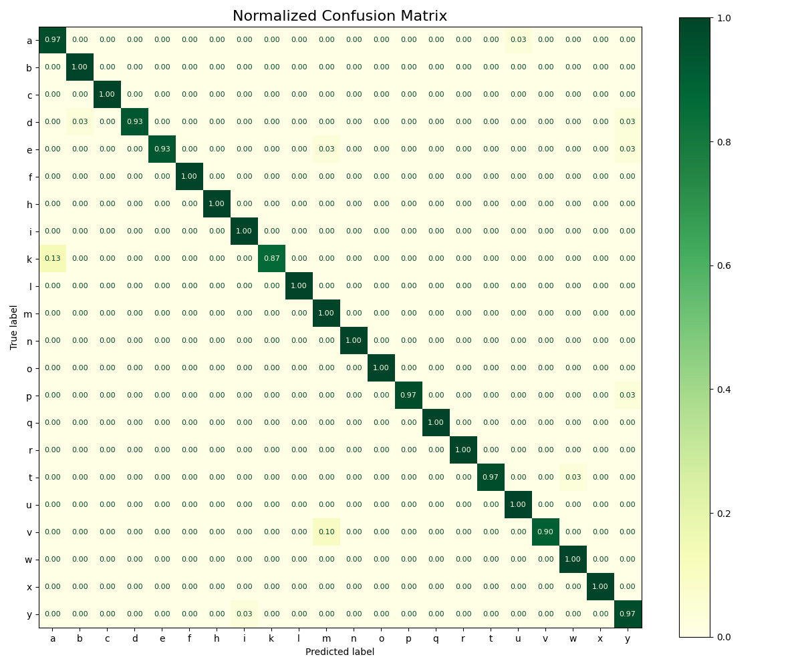
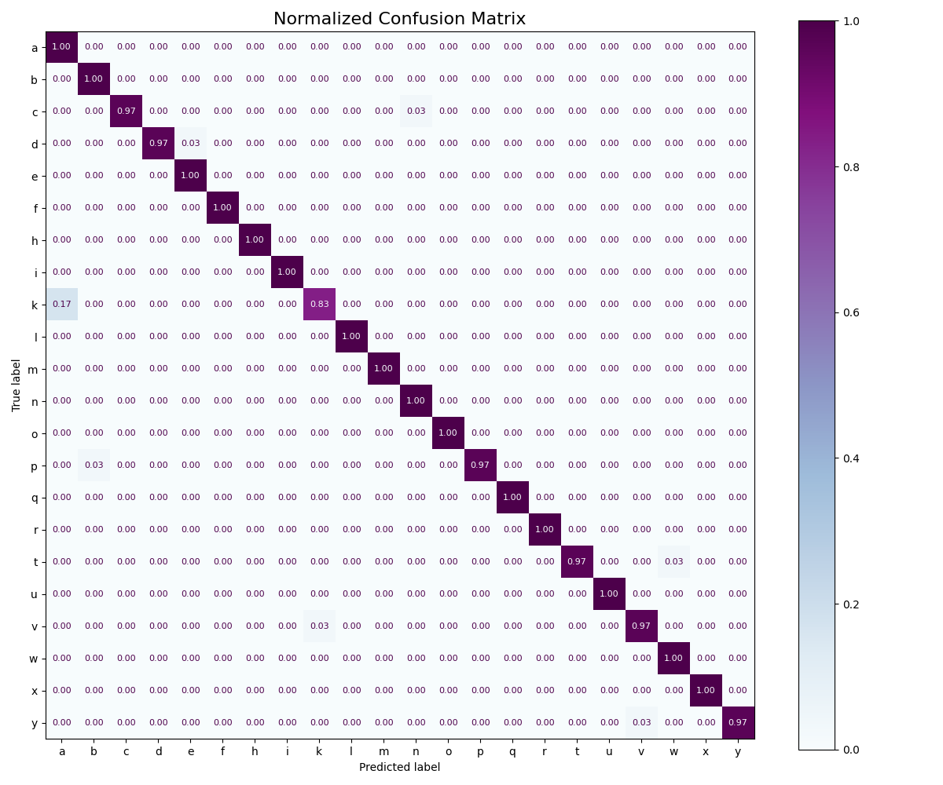
VGG16 - LIS - 64 - 20
VGG19 - LIS - 32 - 15
30
Sign Language Translator: Results
Sign Language Translator: Results

Slide 31
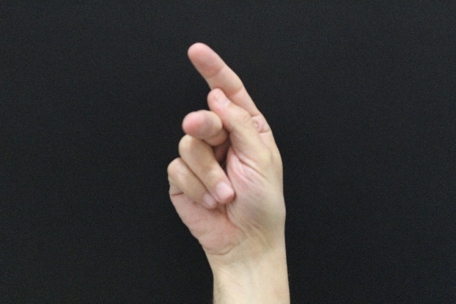
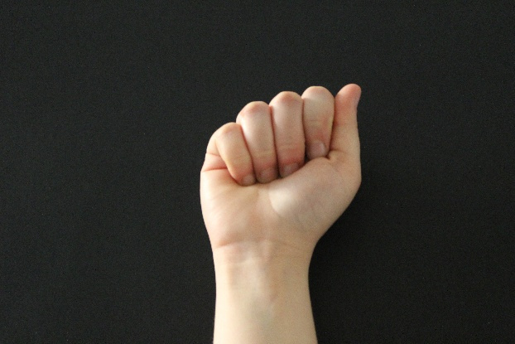
K
A
31
Sign Language Translator: Results
Sign Language Translator: Results

Slide 32
VGG16 BSL
VGG19 BSL
Batch/ Epochs | Accuracy | Precision | Recall | F1-score
16/10 | 0.82 | 0.86 | 0.82 | 0.81
32/15 | 0.89 | 0.89 | 0.89 | 0.89
64/20 | 0.87 | 0.89 | 0.87 | 0.85
Batch/ Epochs | Accuracy | Precision | Recall | F1-score
16/10 | 0.92 | 0.94 | 0.92 | 0.92
32/15 | 0.96 | 0.96 | 0.96 | 0.96
64/20 | 0.93 | 0.94 | 0.93 | 0.93
32
Sign Language Translator: Results

Slide 33
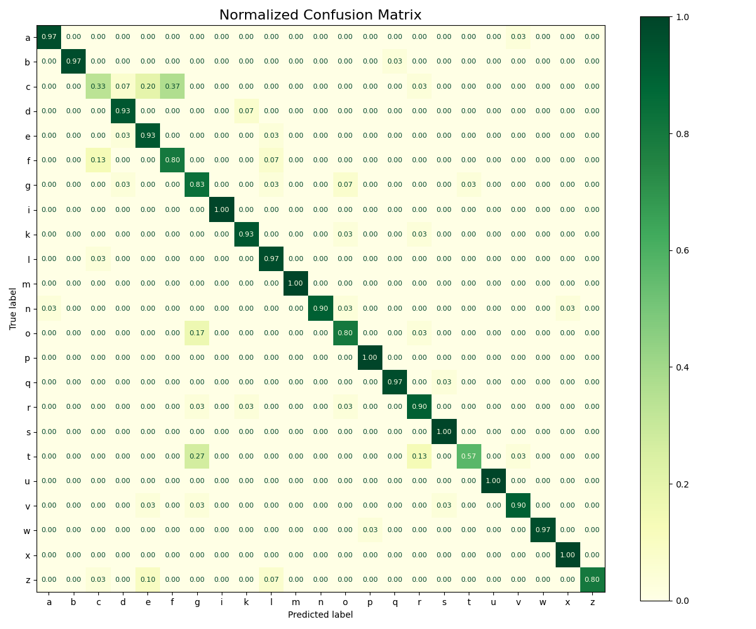

VGG16 - BSL - 32 - 15
VGG19 - BSL - 32 - 15
33
Sign Language Translator: Results

Slide 34
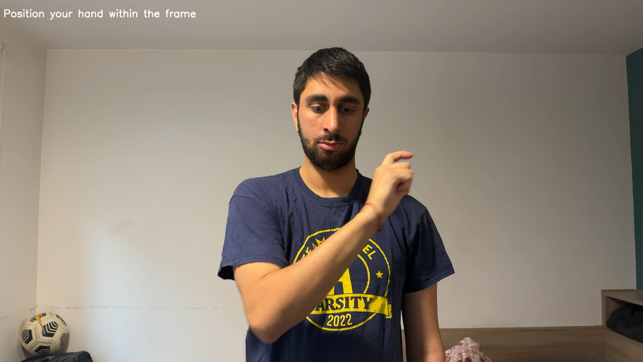
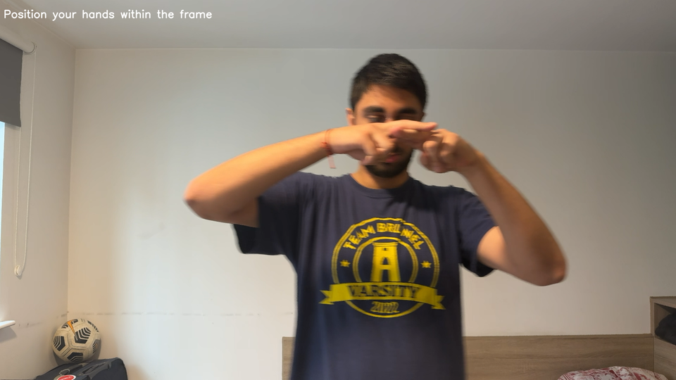
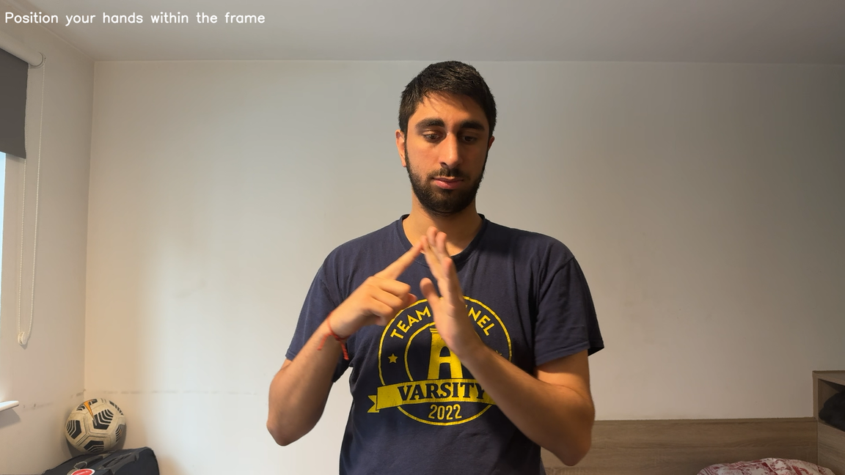
C
F
E
34
Sign Language Translator: Results

Slide 35
VGG16 ASL
VGG19 ASL
Batch/ Epochs | Accuracy | Precision | Recall | F1-score
16/10 | 0.83 | 0.85 | 0.83 | 0.83
32/15 | 0.86 | 0.87 | 0.86 | 0.86
64/20 | 0.87 | 0.88 | 0.87 | 0.86
Batch/ Epochs | Accuracy | Precision | Recall | F1-score
16/10 | 0.75 | 0.81 | 0.75 | 0.75
32/15 | 0.97 | 0.97 | 0.97 | 0.97
64/20 | 0.94 | 0.94 | 0.94 | 0.94
35
Sign Language Translator: Results

Slide 36
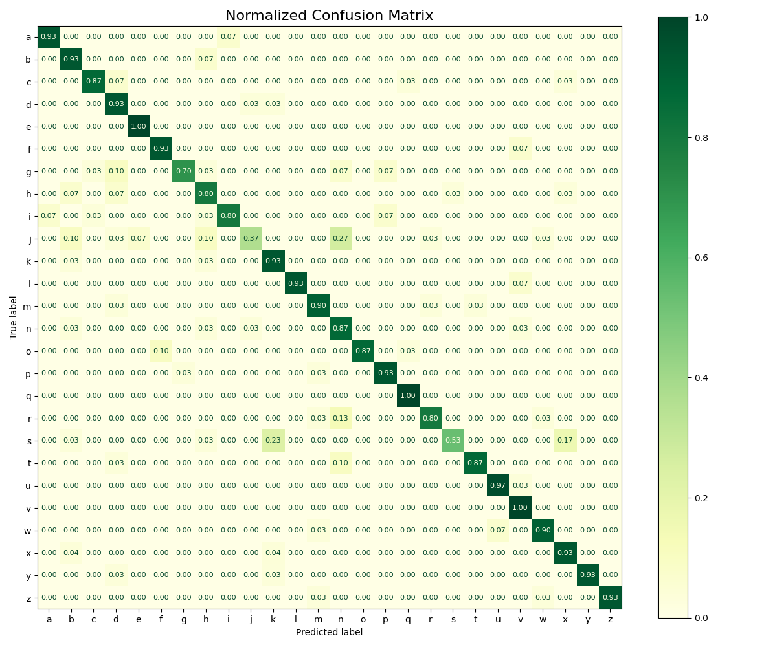
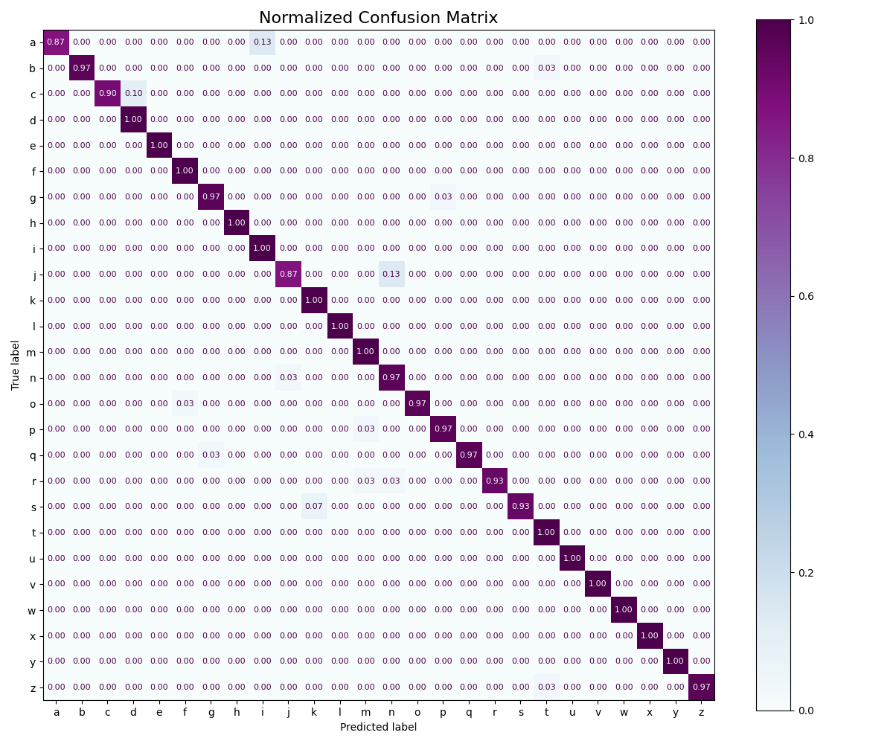
VGG16 - ASL - 64 - 20
VGG19 - ASL- 32 - 15
36
Sign Language Translator: Results

Slide 37
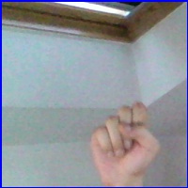
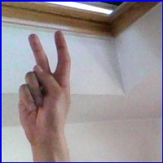
S
K
37
Sign Language Translator: Results

Slide 38

Conclusions
individual datasets
Batch/Epochs | Dataset | EfficientNetV2 | MobileNetV2 | VGG16 | VGG19 | ResNet50 | ResNet50
16/10 | LIS BSL ASL | 0.93 0.95 0.95 | 0.73 0.74 0.78 | 0.97 0.82 0.83 | 0.98 0.92 0.75 | 0.96 0.97 0.96 | 0.89 0.93 0.95
32/15 | LIS BSL ASL | 0.94 0.88 0.96 | 0.74 0.75 0.76 | 0.97 0.89 0.86 | 0.98 0.96 0.97 | 0.96 0.97 0.97 | 0.91 0.94 0.96
64/20 | LIS BSL ASL | 0.93 0.90 0.96 | 0.73 0.70 0.77 | 0.97 0.87 0.87 | 0.97 0.93 0.94 | 0.97 0.96 0.96 | 0.90 0.93 0.95
— Aggiungi la fonte o l'autore

Slide 39
Conclusions
combined dataset
Batch/Epochs | EfficientNetV2 | MobileNetV2 | VGG16 | VGG19 | ResNet50
16/10 | 0.92 | 0.74 | 0.89 | 0.84 | 0.93
32/15 | 0.93 | 0.75 | 0.94 | 0.83 | 0.95
64/20 | 0.92 | 0.75 | 0.96 | 0.76 | 0.95
— Aggiungi la fonte o l'autore

Slide 40
References
[1] Grassknoted. ASL Alphabet. Kaggle. https://www.kaggle.com/datasets/grassknoted/asl-alphabet
[2] Nisopoli, Nicholas. LIS Dataset. Kaggle. https://www.kaggle.com/datasets/nicholasnisopoli/lisdataset
[3] Tatepe, Eren. BSL Numbers and Alphabet Hand Position for MediaPipe. Kaggle.
https://www.kaggle.com/datasets/erentatepe/bsl-numbers-and-alphabet-hand-position-for-mediapipe
[4] K. He, X. Zhang, S. Ren and J. Sun, "Deep Residual Learning for Image Recognition," 2016 IEEE
Conference on Computer Vision and Pattern Recognition (CVPR), Las Vegas, NV, USA, 2016, pp. 770-778,
doi: 10.1109/CVPR.2016.90.
[5] He, K., Zhang, X., Ren, S., and Sun, J. Delving Deep into Rectifiers: Surpassing Human-Level Performance
on ImageNet Classification. arXiv, 2015.
[6] Thakur, Ayush. Keras Dense Layer: How to Use It Correctly. Weights & Biases
[7]Mark Sandler and Andrew Howard and Menglong Zhu and Andrey Zhmoginov and Liang-Chieh Chen. "MobileNetV2: Inverted Residuals and Linear Bottlenecks." arXiv preprint arXiv:1801.04381 (2019).
[8]Mingxing Tan and Quoc V. Le. "EfficientNet: Rethinking Model Scaling for Convolutional Neural Networks." arXiv preprint arXiv:1905.11946(2019).
[9] Simonyan, Karen. "Very deep convolutional networks for large-scale image recognition." arXiv preprint arXiv:1409.1556 (2014).
[10] Amerini I. "Lecture 9: Recognition" Computer Vision course, Università di Roma La Sapienza, PowerPoint presentation (A.A. 2023-2024)

Slide 41
Thank you!

